Slide 1

SLIIT ITP PROJECT PROPOSAL ITP PROJECT – CSIT2080 Group – ITP21F_05 2nd Year,2nd Semester - 2021

Slide 2
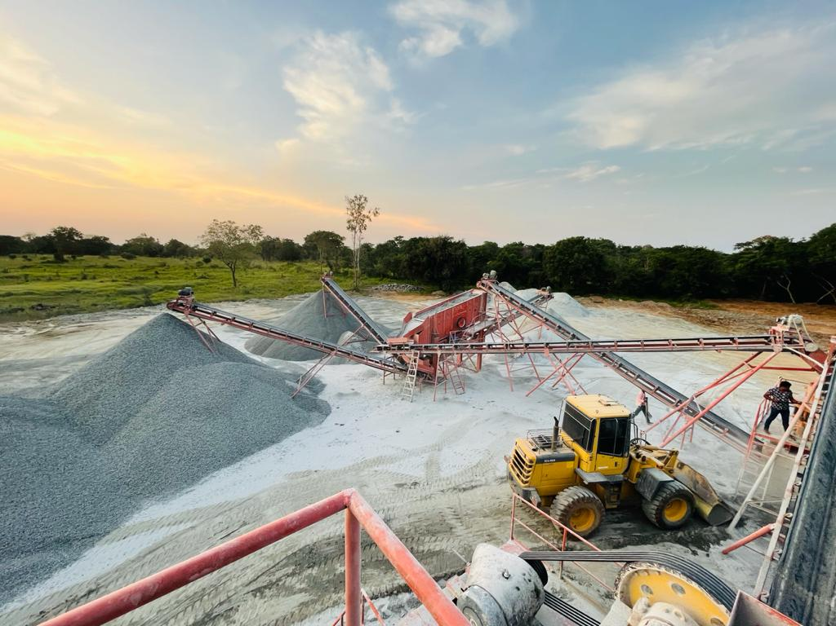

HERATH METAL CRUSHER METAL CRUSHER MANAGEMENT SYSTEM
-

Slide 3
PROJECT MEMBERS
Ravinda Anjana S.A.D - IT20062538
Dakumpitiya D.A.L.C - IT20187200
Bandara S.A.C.J.W - IT20197278
Wijesinghe W.A.K.R - IT20751296
Nigamuni M.M.S - IT20189426
Kadigamuwa A.S.T.W.M.R.R.W - IT20197100
Mithsara K.A.G.N - IT20190170
Ariyathilake H.L - IT20245788

Slide 4
Introduction
HERATH METAL CRUSHER is a Metal Crusher which was built up in 2006.
Location – Anuradhapura District
Currently HERATH METAL CRUSHER is using a manual system to handle the crusher’s process.
Our group is interested in building up a new system for the Metal Crusher to manage all their processes efficiently

Slide 5
Problem Specification

Slide 6
Solution Outline

Slide 7
Key Benefits

Slide 8
System Overview

Slide 9
System Functions
Vehicle Repairing, Workload and Maintenance Management of Vehicles
Metal Crusher Machines Repairing, Workload and Maintenance Management
Loader Machines Repairing, Workload and Maintenance Management
Generator Machines Repairing, Workload and Maintenance Management and Sales Management
Administrative Tasks and Employee Attendance Management
Hammer, Compressor Machines Repairing, Workload and Maintenance Management
Excavator Machines Repairing, Workload and Maintenance Management
Other Remaining Items in Stock Management

Slide 10
Vehicle Repairing, Workload and Maintenance Management of Vehicles

Slide 11
Metal Crusher Machines Repairing, Workload and Maintenance Management

Slide 12
Loader Machines Repairing, Workload and Maintenance Management

Slide 13
Generator Machines Repairing, Workload and Maintenance Management and Sales Management

Slide 14
Administrative Tasks and Employee Attendance Management

Slide 15
Hammer, Compressor Machines Repairing, Workload and Maintenance Management

Slide 16
Excavator Machines Repairing, Workload and Maintenance Management

Slide 17
Other Remaining Items in Stock Management

Slide 18
Other Remaining Items in Stock Management

Slide 19
Tools & Technologies
Planning to use software s like,
Eclipse – for IDE to code implementation
Java – as a programming language
Scene Builder – to develop the UI / UX
MongoDB , MYSQL – to create the database
Develop a desktop application using JavaFx frame work.
Other necessary libraries will be used to create quality UI and UX

Slide 20
Conclusion

Slide 21
Thank You!

